Slide 1
Parallel Implementation of Poisson’s Equation
Solving Poisson's equation using Jacobean finite difference method
By
Aly Karim
Hanfy Ahmed
Jatta Mustapha
Muna Isyna
Hamid Qazi
Notes:
Are your classroom colors different than what you see in this template? That’s OK! Click on Design -> Variants (the down arrow) -> Pick the color scheme that works for you!
Feel free to change any “You will…” and “I will…” statements to ensure they align with your classroom procedures and rules!

Slide 2

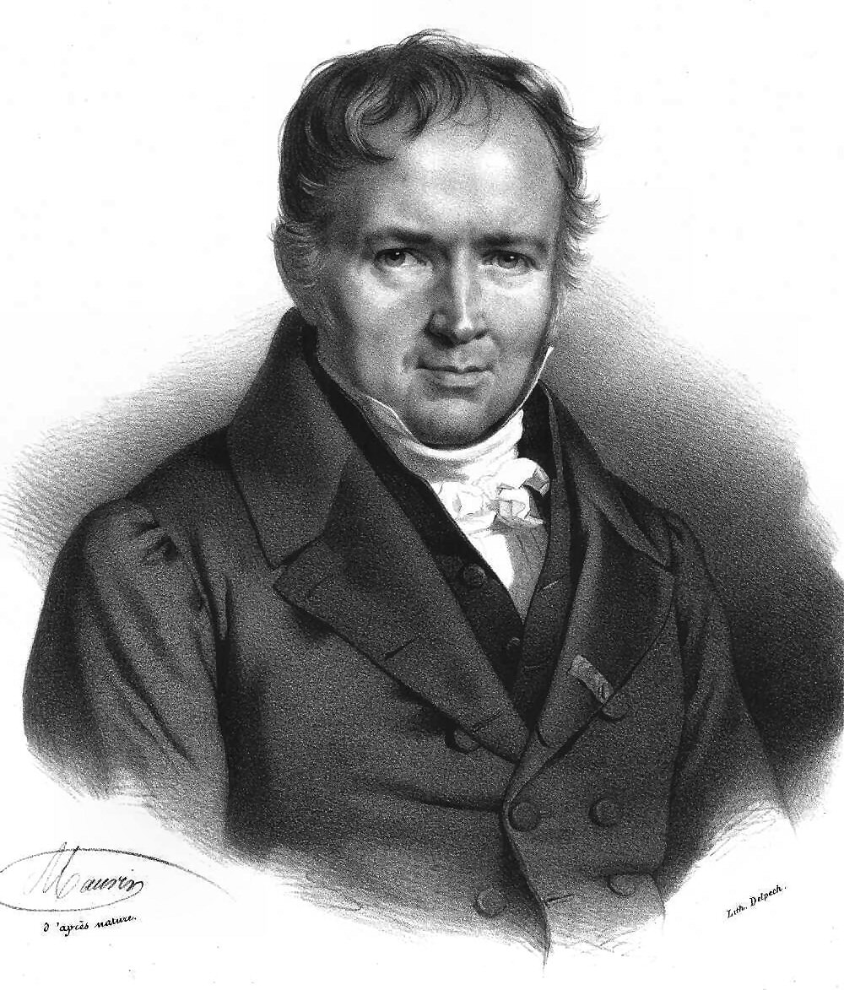
Content
Poisson Equation
Introduction
Finite Difference method
Poisson Solution Algorithms
Serial Algorithm
Parallel Algorithm
Results and Discussion
Problem size
Number of processors Time Effect
Number of processors and speed up

Slide 3

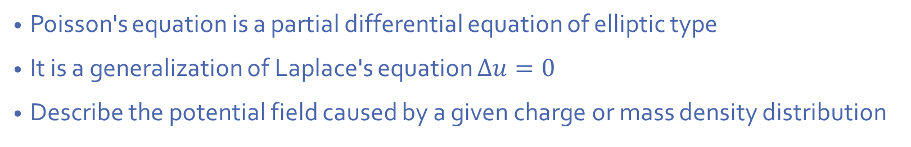
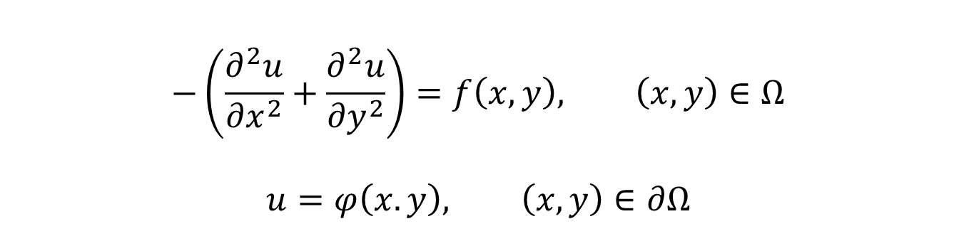
Poisson Equation
$$−\left(\frac{∂^{2}u}{{∂x}^{2}}+\frac{∂^{2}u}{{∂y}^{2}}\right)=f\left(x,y\right), \left(x,y\right)∈Ω$$
$$u=φ\left(x.y\right), \left(x,y\right)∈∂Ω$$
Poisson's equation is a partial differential equation of elliptic type
It is a generalization of Laplace's equation $∆u=0$
Describe the potential field caused by a given charge or mass density distribution

Slide 4

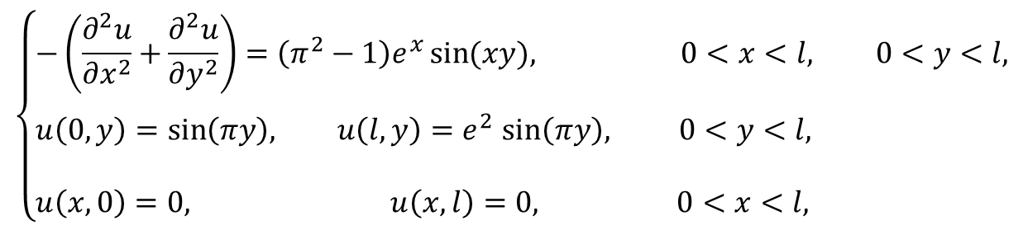
Selected Problem
$$\left\{\begin{aligned}&−\left(\frac{∂^{2}u}{{∂x}^{2}}+\frac{∂^{2}u}{{∂y}^{2}}\right)=\left(π^{2}−1\right)e^{x}\sin{(xy), 0<x<l, 0<y<l,} \\ \\ &u\left(0,y\right)=\sin\left(πy\right), u\left(l,y\right){=e}^{2}\sin\left(πy\right), 0<y<l, \\ \\ &u\left(x,0\right)=0, u\left(x,l\right)=0, 0<x<l,\end{aligned}\right.$$
A two-dimensional Poisson equations with Dirichlet boundary condition.
The exact solution of the problem is $u\left(x,y\right)=e^{x}sin{(πy)}$ .

Slide 5
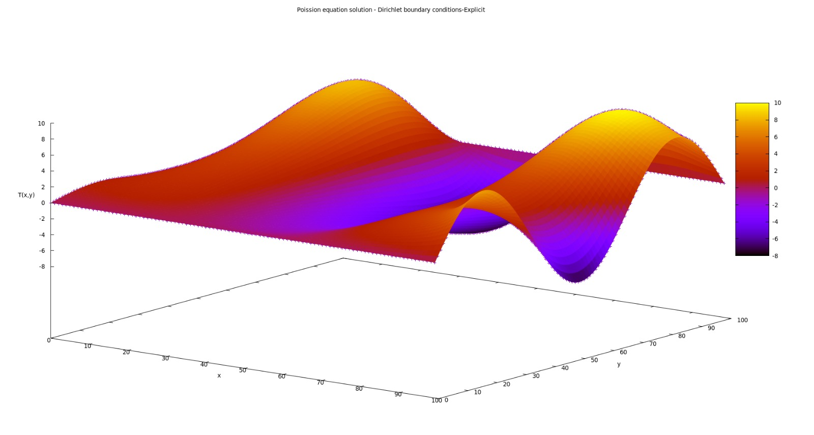
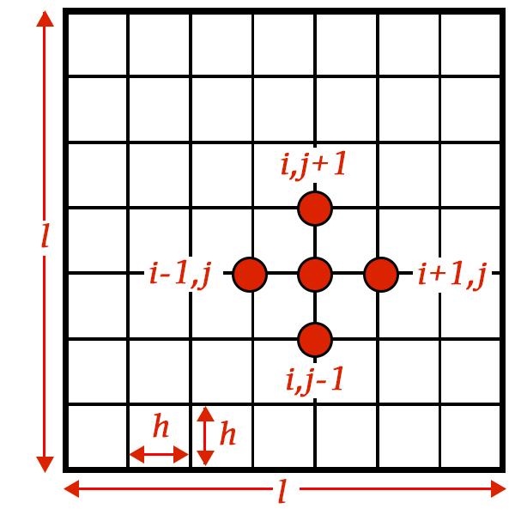
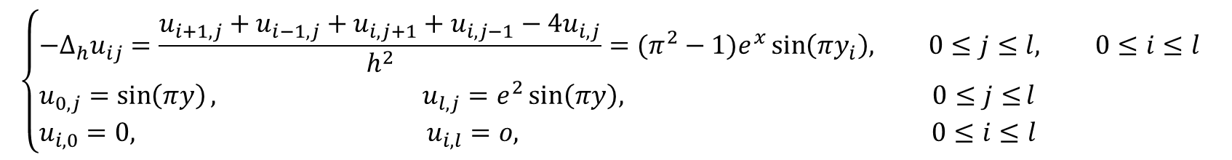
Finite Difference Approximation
$$\left\{\begin{aligned}&{−∆}_{h}u_{ij}=\frac{u_{i+1,j}+u_{i−1,j}+u_{i,j+1}+u_{i,j−1}−{4u}_{i,j}}{h^{2}}=(π^{2}−1)e^{x}\sin\left(πy_{i}\right), 0≤j≤l, 0≤i≤l \\ &u_{0,j}=\sin\left(πy\right), u_{l,j}=e^{2}\sin\left(πy\right), 0≤j≤l \\ &u_{i,0}=0, u_{i,l}=o, 0≤i≤l\end{aligned}\right.$$

Slide 6
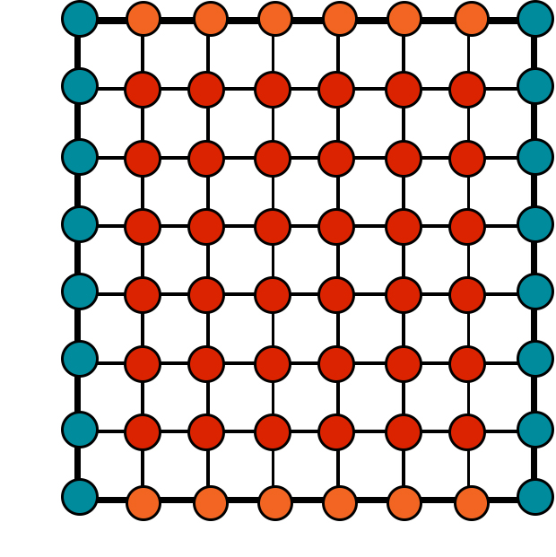





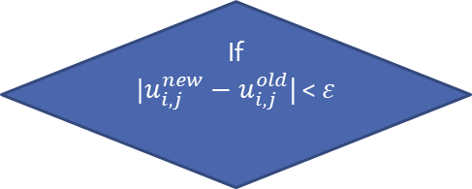


Poisson Serial Algorithm
Initiate the grid matrix
Solution elements = 0
Zeros boundary
Function boundary
$$u_{i,0}=0$$
Record time
Start solution for ${u_{i,j}^{new}}_{ }$
$$u_{0,j}=\sin\left(πy\right)$$
$$u_{l,j}=e^{2}\sin\left(πy\right)$$
Max. Number of iterations ${10}^{5}$
If
${|u}_{i,j}^{new}−u_{i,j}^{old}$| < $ε$
Time difference is serial time
$ε$ = ${10}^{−5}$
Save the solution to a file and plot
Record time
$$u_{i,l}=o$$

Slide 7
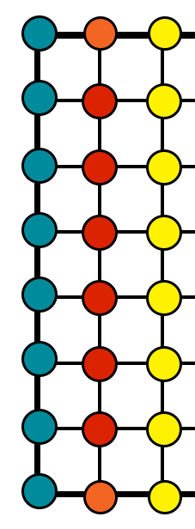
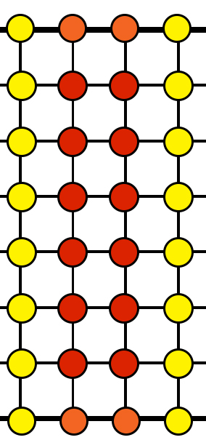
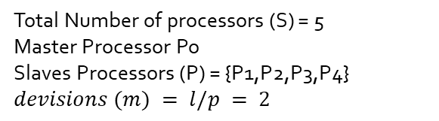
Poisson Parallel Algorithm
1
2
3
Total Number of processors (S) = 5
Master Processor Po
Slaves Processors (P) = {P1,P2,P3,P4}
$$devisions (m) = l/p = 2$$
4
5
6
7
8
9
10
11
12
13
14
15
16
17
18
19
20
21
22
23
24
P1
P3
P4
P2

Slide 8


Poisson Parallel Algorithm
$$l=8$$
P1
1 2 3 4 5 6 7 8 9 10 11 12 13 14 15 16 17 18 19 20 21 22 23 24
P2
1 2 3 4 5 6 7 8 9 10 11 12 13 14 15 16 17 18 19 20 21 22 23 24 25 26 27 28 29 30
P3
1 2 3 4 5 6 7 8 9 10 11 12 13 14 15 16 17 18 19 20 21 22 23 24 25 26 27 28 29 30
P4
1 2 3 4 5 6 7 8 9 10 11 12 13 14 15 16 17 18 19 20 21 22 23 24
Master Task:
Get the size of the Grid from user
Spilt the array into $(m+1)∗l$or $(m+2)∗l$elements
Send the vectors to processors

Slide 9
Poisson Parallel Algorithm
0
0
0
0
0
0
0
0

Slide 10
Results
Problem size and number of processors

Slide 11
Results
Number of processors with time
Problem size100

Slide 12
Results
Number of processors with time
Problem size 300

